Slide 1
PACE-UP Next-Steps Web App

Slide 2
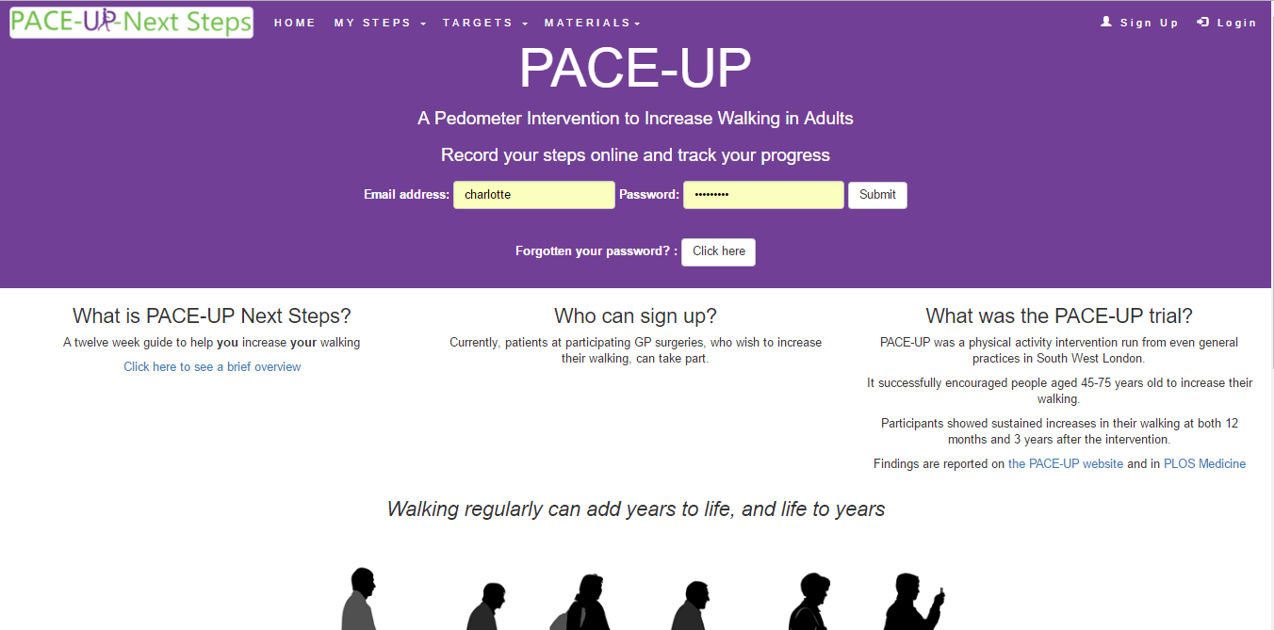
Added:
Link to overview of targets
Explanation of PACE-UP trial as per booklet

Slide 3

New Admin dialog (all functional)

Slide 4
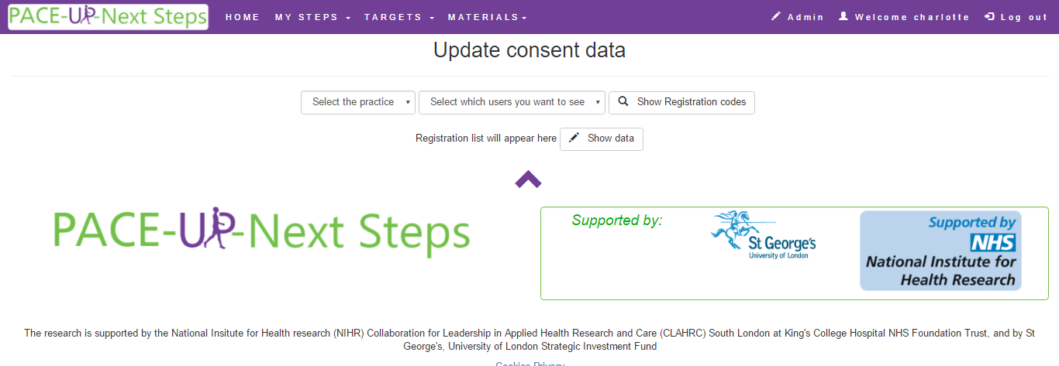
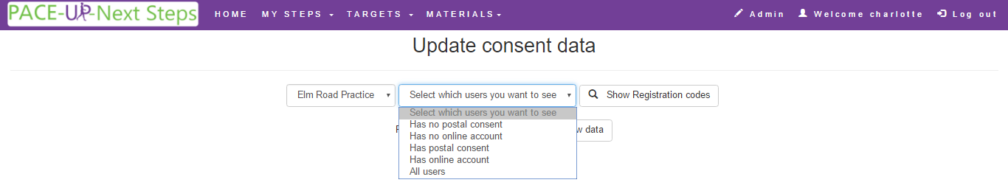
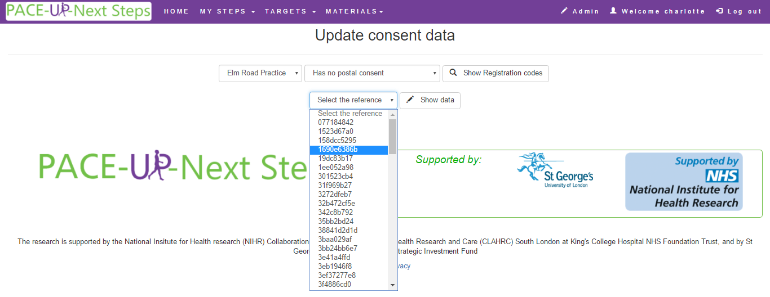

Slide 5
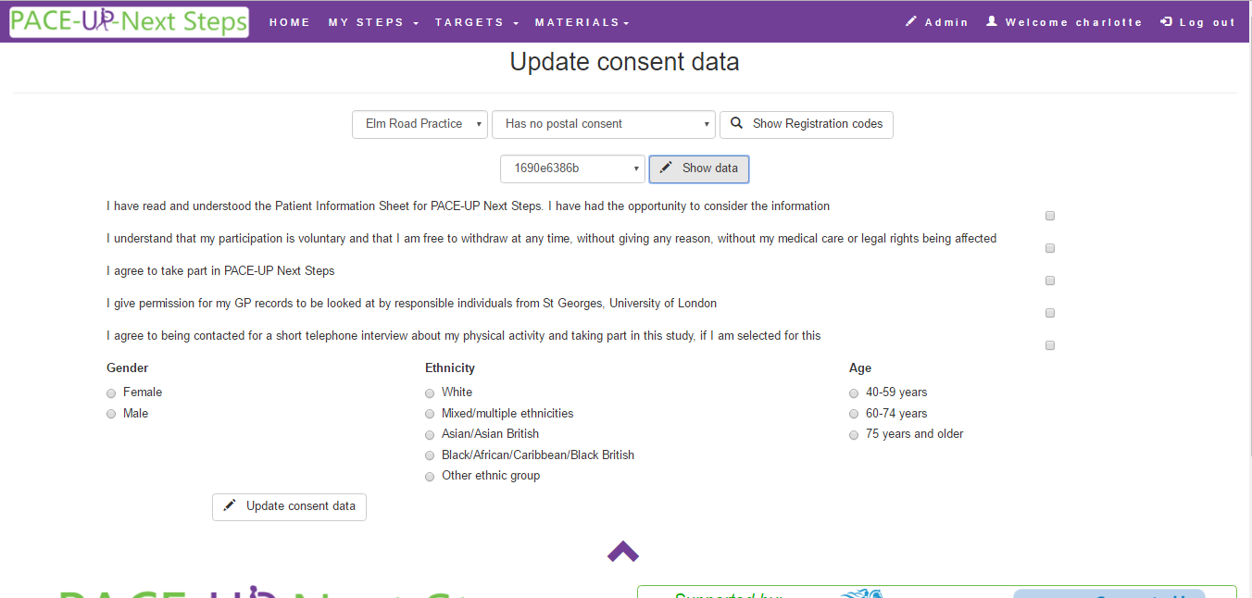
Consent form data can be entered here by the researcher.
On recruitment this individual should not be asked for their consent details

Slide 6
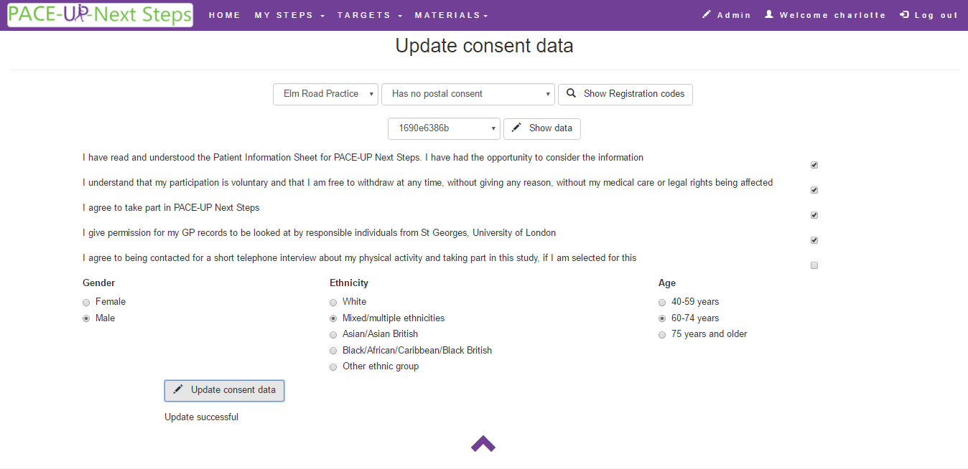

Slide 7
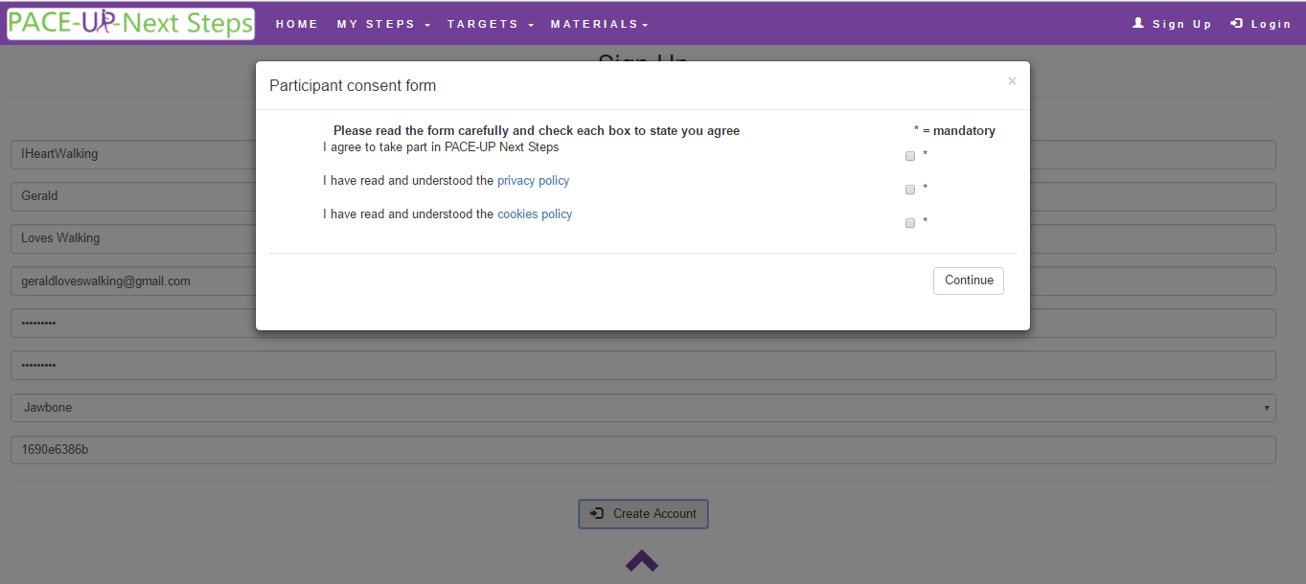
Registering when has postal consent

Slide 8
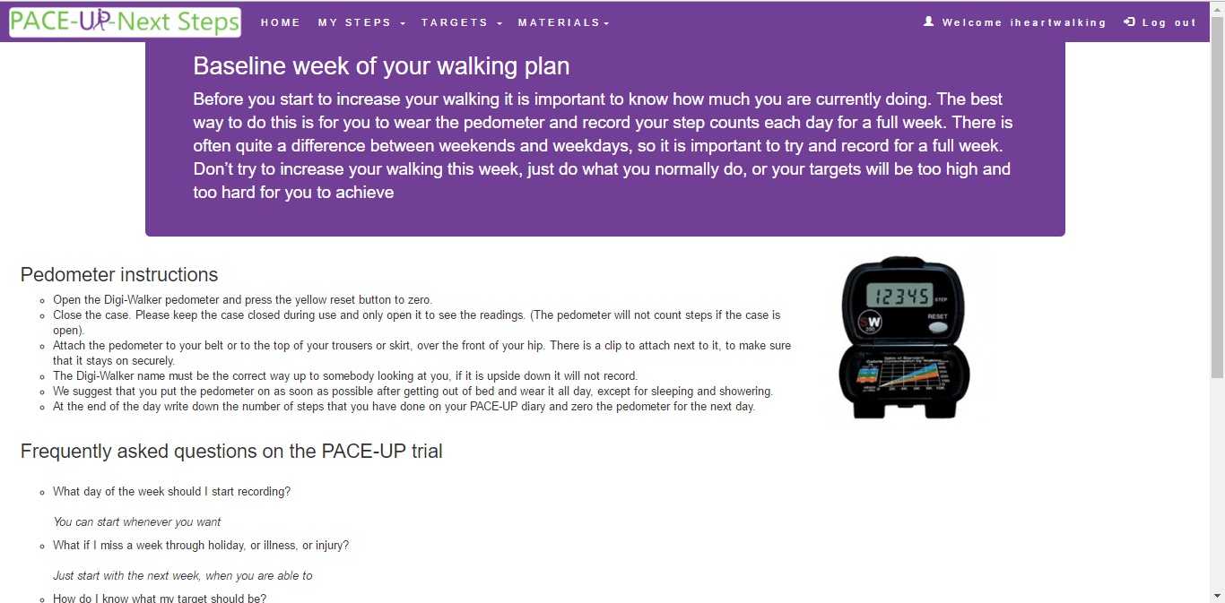
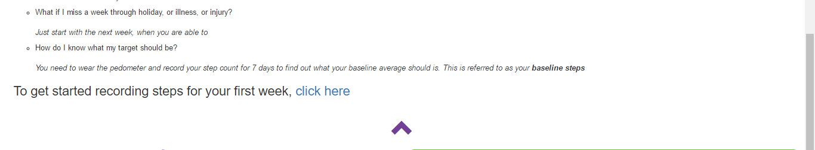
Intro

Slide 9
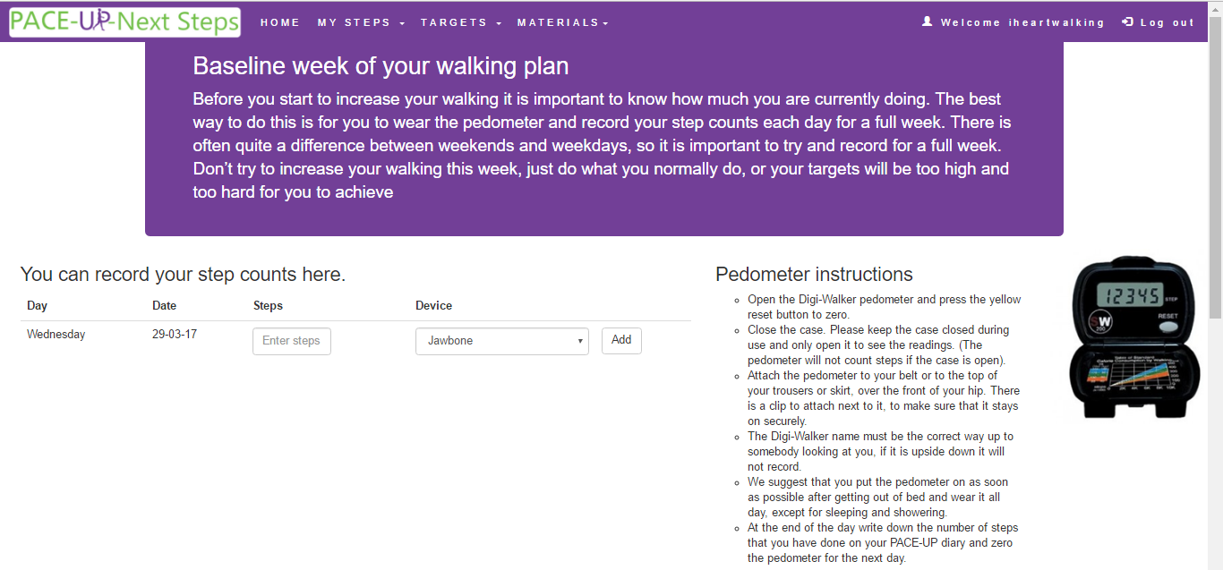
First Steps

Slide 10
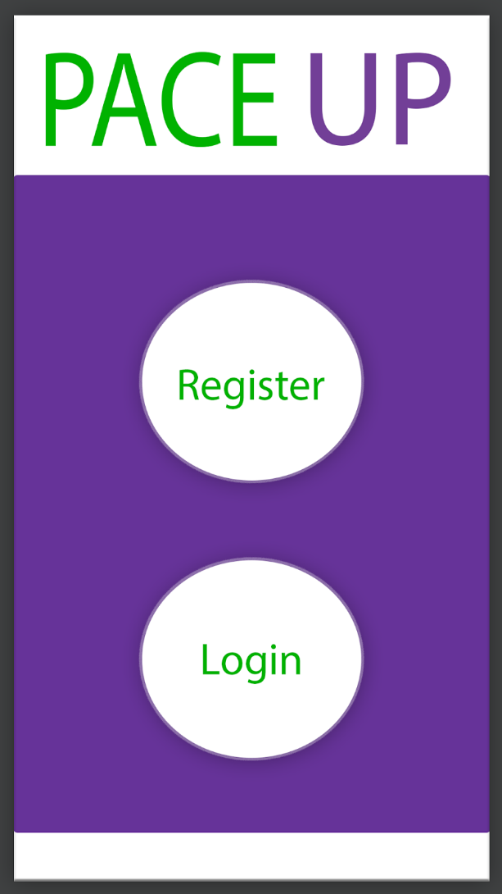
Mobile – Login screen

Slide 11

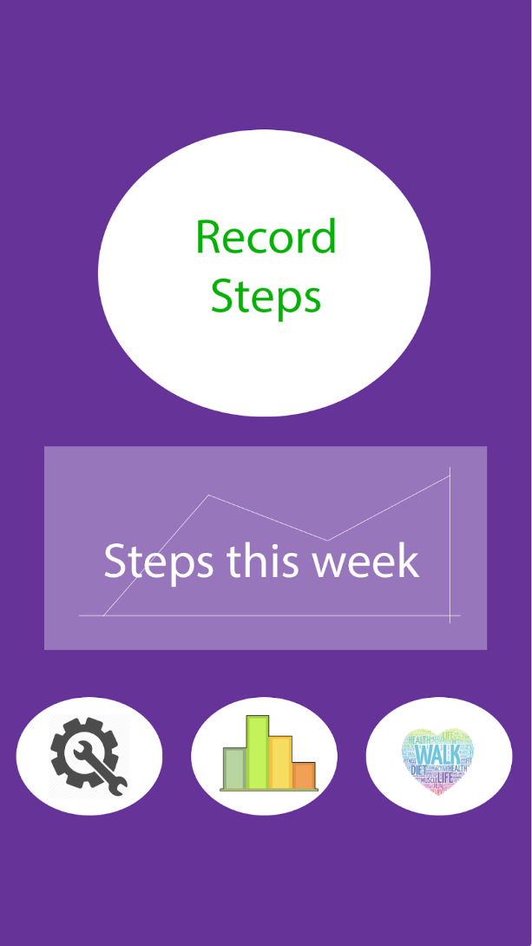
Mobile – control panel

Slide 13
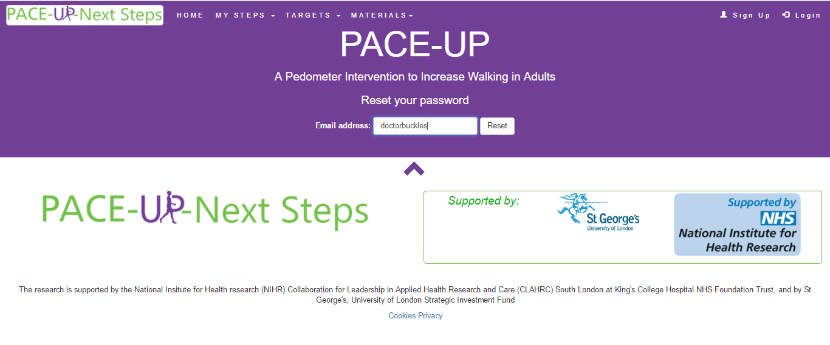
Password Reset

Slide 14
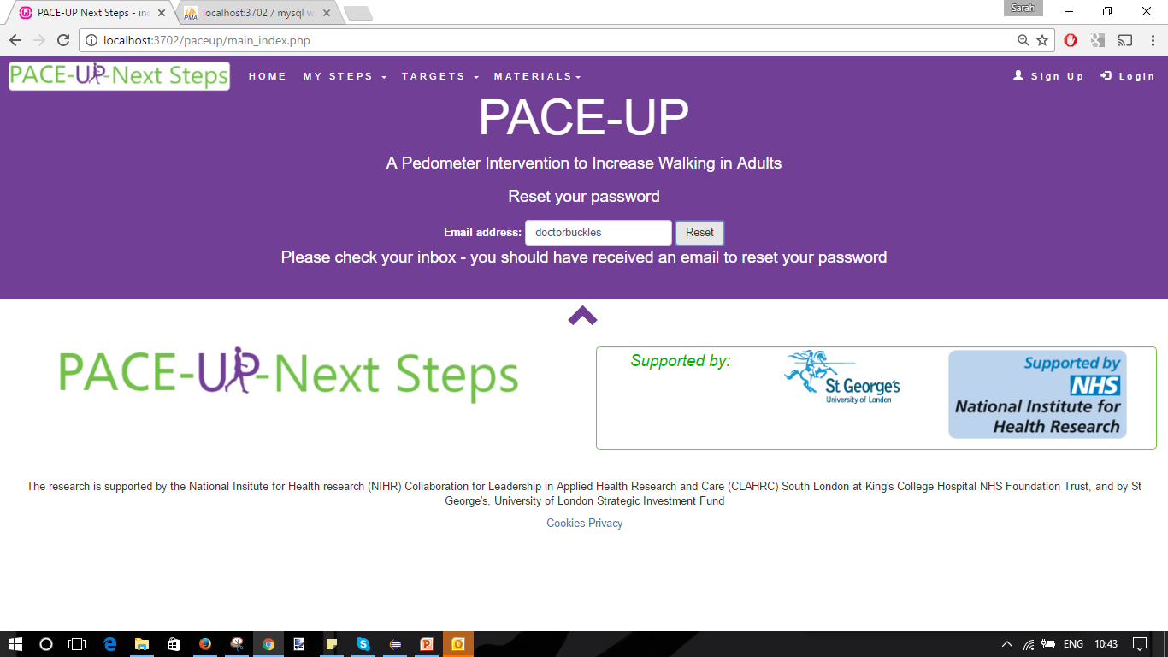
Password Reset

Slide 15
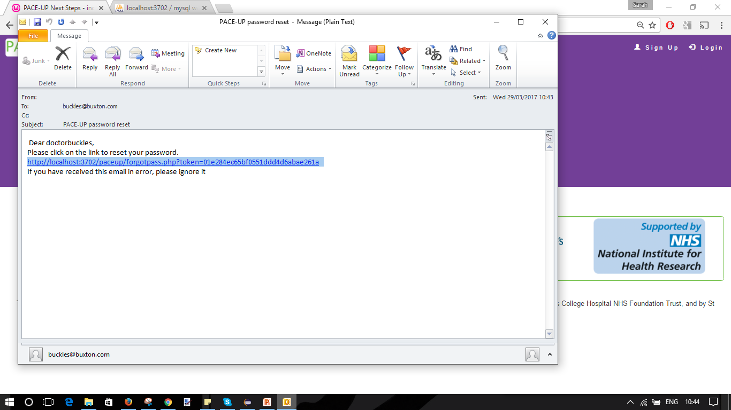
Password Reset

Slide 16
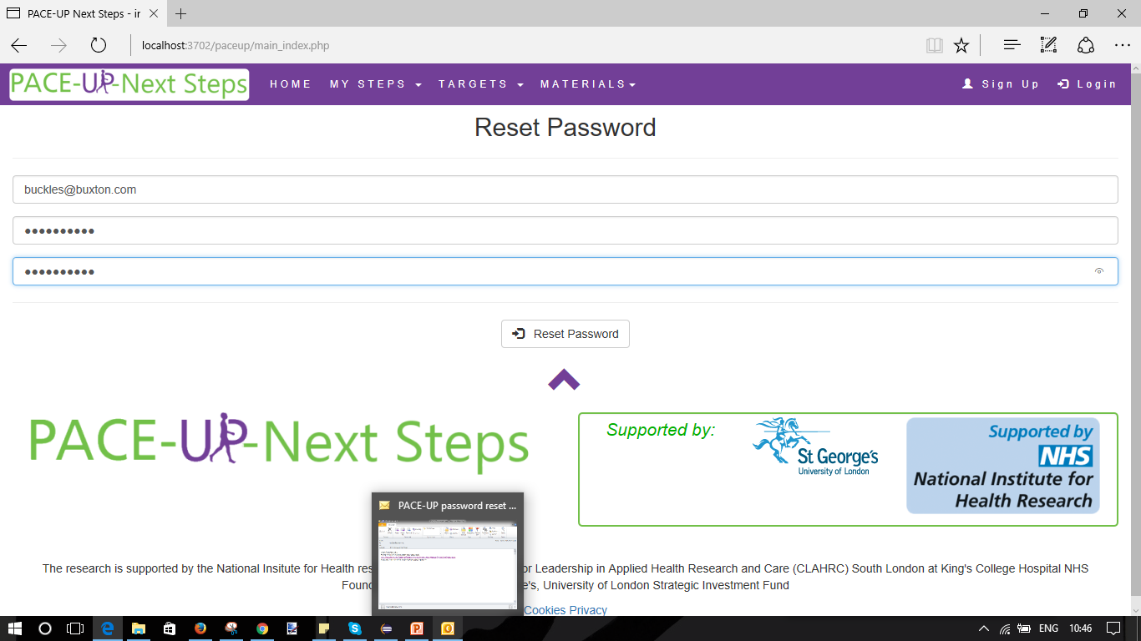
Reset Password

